Slide 1


IMAGE PROCESSING FOR MASK DETETCTION
B.Tech 3rd Sem @ IIIT Pune
Independent Project Presentation

Slide 2
WHAT YOU’RE GOING TO SEE?
LITERATURE
RESEARCH GAPS
OBJECTIVES

Slide 3
WHAT YOU’RE GOING TO SEE?
METHODOLOGY
WORK DONE SO FAR
CONCLUSION AND REFERENCES

Slide 4
INTRODUCTION
Image processing is a method to perform some operations on an image, in order to get an enhanced image or to extract some useful information from it.
It is a type of signal pro-cessing in which input is an image and output may be image or characteristics/features associated with that image.

Slide 5
INTRODUCTION
Image processing basically includes the following three steps:
Importing the image via image acquisition tools.
2. Analysing and manipulating the image.
3. Output in which result can be altered image or report that is based on image analysis.

Slide 6
MOTIVATION OVERVIEW
In an effort to paint a more complete picture, we decided to show the creative process behind a solution for a seemingly simple use case in computer vision:
Detect people that pass through a security-like camera.
2. Identify face mask usage.
3. Collect reliable statistics (people wearing masks)

Slide 7
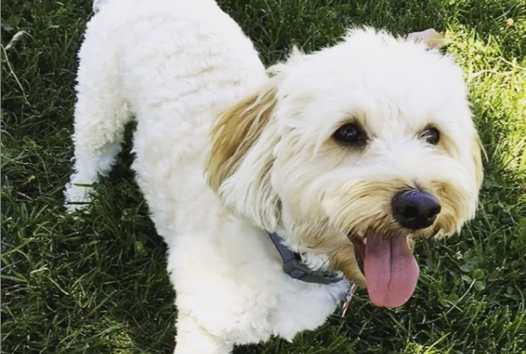
LITERATURE
A common use of machine learning is to identify what an image represents. For example, we might want to know what type of animal appears in the following photograph.
The task of predicting what an image represents is called image classification. An im-age classification model is trained to recognize various classes of images.

Slide 8
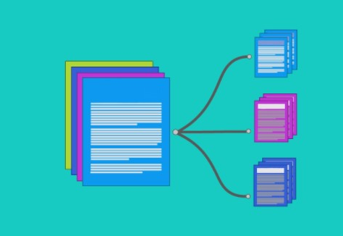
LITERATURE
A simple representation of classification of an image and then narrowing it down to a particular field.
\
A more detailed explanation for the same is mentioned in the report.

Slide 9



OBJECTIVE
To detect, classify and differentiate masked and unmasked people with a reasonably acceptable accuracy using various supplementary libraries:
OpenCV TensorFlow Python

Slide 10
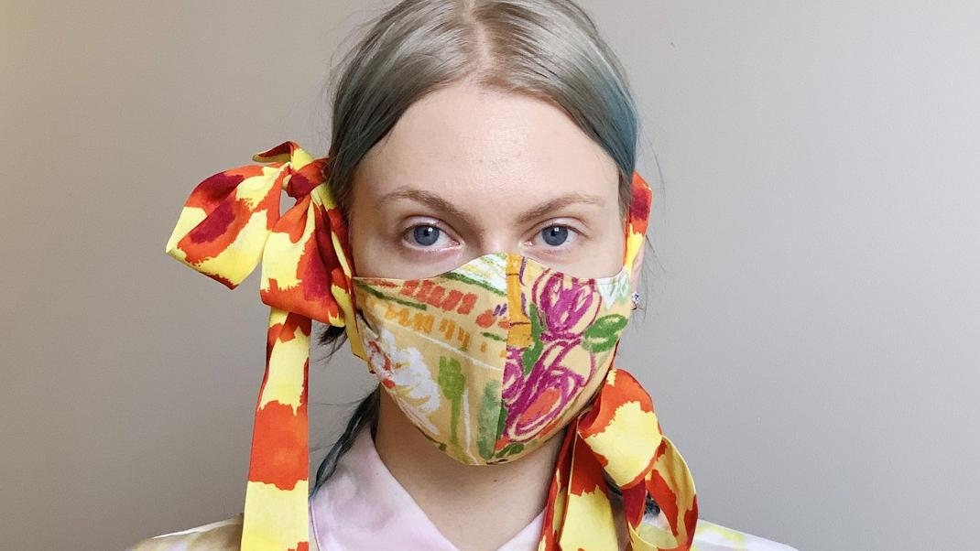
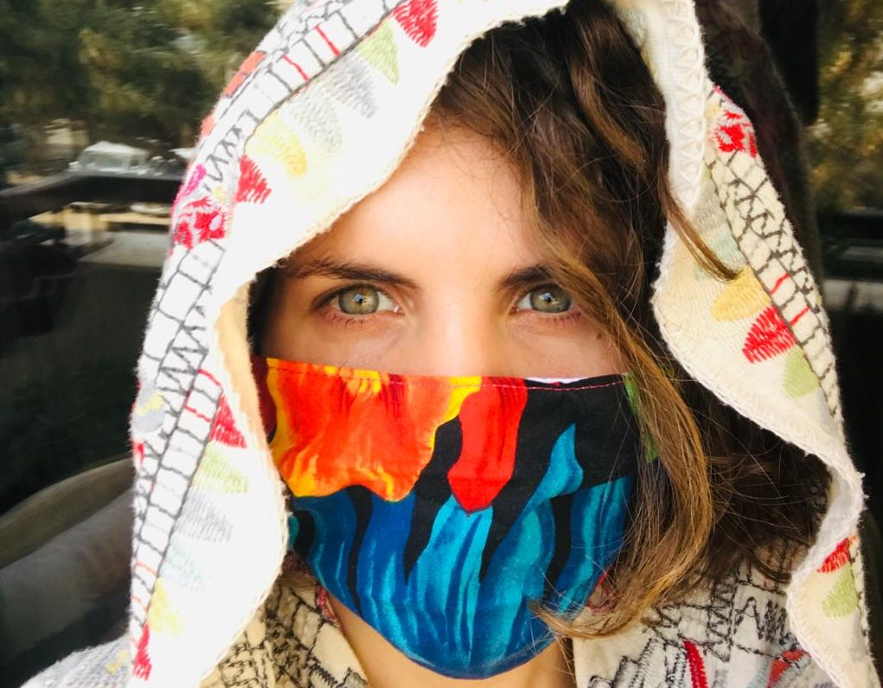
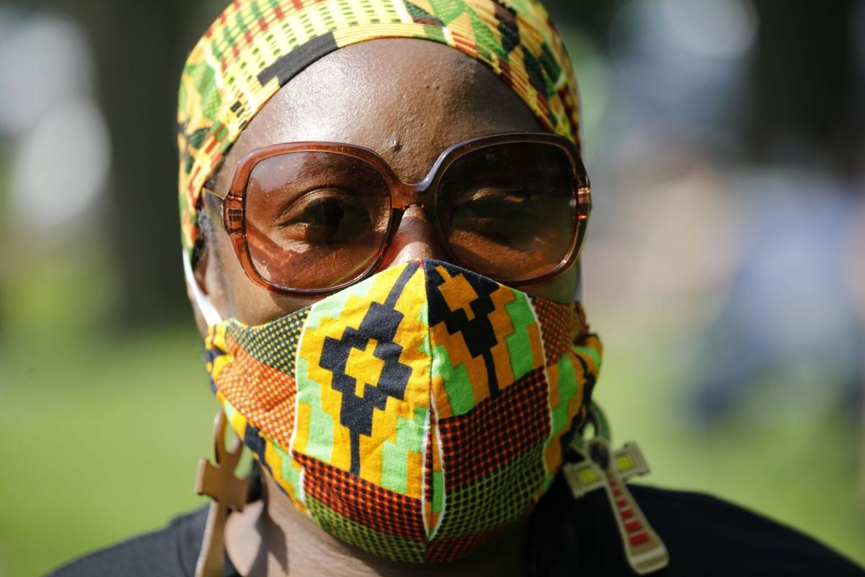
RESEARCH GAPS
Dataset with enough variety to deal with current variety of Masks

Slide 11


RESEARCH GAPS
Datasets are resourced from Kaggle, Git-hub which are Independent and therefore we lack total con-rol over it.

Slide 12
MACHINE LEARNING
Machine learning is an application of artificial intelligence (AI) that provides systems the ability to automatically learn and improve from experience without being explicitly programmed

Slide 13
DEEP LEARNING
Deep learning is a subset of machine learning where artificial neural networks, algorithms inspired by the human brain, learn from large amounts of data.

Slide 14
METHODOLOGY
1. Decided on the problem statement after much though around the Current affairs happening around the world vis-`a-vis the Pandemic and how we could work around that.

Slide 15
METHODOLOGY
2.Sourcing the Dataset from pre-existing images on relevant sites.

Slide 16
METHODOLOGY
3. Processing the dataset to optimize it for our Problem statement.

Slide 17
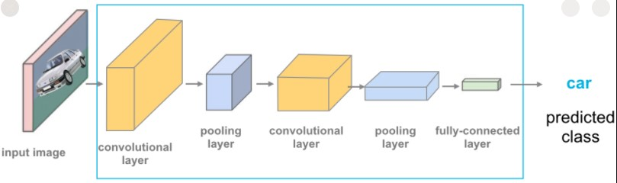
METHODOLOGY
4. Model Selection for an appropriate fit.

Slide 18



METHODOLOGY
5.Optimising it for the Dataset.
Downsizing Color Optimization

Slide 19
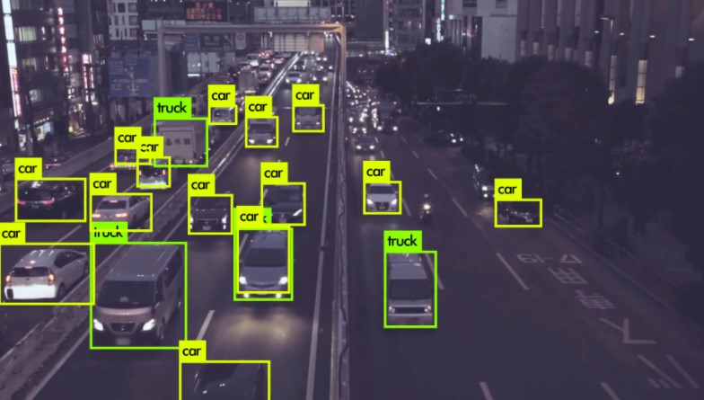
METHODOLOGY
6. Using OpenCV to employ a realtime detection for a video input

Slide 20
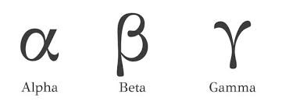
METHODOLOGY
7. Testing it for a varying choice of parameters and Hyperparameters.

Slide 21
METHODOLOGY
8. Establishing the final working model.

Slide 22
WORK DONE SO FAR
Obtained some part of the dataset.
Decided on what processing to do for optimum results.
Got Acquainted with the Various Algorithms involved and the Libraries used to implement them.

Slide 23
CONCLUSION
We hope to achieve a tangible impact over a real world problem that is actively plaguing the world using the recent advances in Data collection, Processing, Analysis and the application of Machine learning on the data

Slide 24


REFERENCES
References : Andrew Ng/Deeplearning.ai
Coursera.org
Ashish Jhangra/Kaggle
ThePerceptron/Youtube

Slide 25
A WARM THANK YOU
Director: Dr. Anupam Shukla
Guide: Dr. Rahul Dixit
HOD: Dr. Tanmoy Hazra
Project By:
Jasraj Singh Chhabda : 111915051
Harsh Prakash : 111915041
Aryan Sharma : 111915018
Amrendra Shendkar : 111915013
Ashish Biswal : 111916013

